Slide 1
CREATING INTEGRATED CREDIT UNION SYSTEMS’ BUSINESS MODELS
WIKTOR KAMIŃSKI
NATIONAL ASSOCIATION OF CO-OPERATIVE SAVINGS AND CREDIT UNIONS, POLAND

Slide 2
POLISH CREDIT UNION SYSTEM
1992 – The first credit union in Poland begins its operations. There was no specific Law on CUs – only one article in Trade Union Law.
CUs were operating only on the base of occupational common bond, usually between employees of one or a few companies (shipyard, coal mine, hospital, etc.) or one occupation (teachers working in schools of certain state administration unit).
1996 – The Credit Union Act becomes effective. The law allows organizing CUs also with organizational common bond (for members of different social organizations: associations, societies, trade unions).
2012 – New Credit Union Act: state regulation and deposit guarantee

Slide 3

POLISH CREDIT UNION SYSTEM MODEL
The adopted model of credit unions is based on diversified membership (various types of bonds between members) and multi-branch organisational structure, offering wide range of various services.
This model is characterized by high ability of adaptation to changeable market conditions and by economic efficiency.
It provides answers to the needs of contemporary society. Thanks to standardising of documentation and procedures, consumers’ interests are appropriately protected, and the activities of credit unions are pursued in a unified, safe manner and according to the rule of law.

Slide 4
Credit Unions in Poland
Credit unions provide access to financial services to common people, enabling them to meet their goals and improve their economic and living conditions. Credit unions are not-for-profit institutions, based on the idea of financial self-help, cooperative values, international credit union principles, ethical economy and corporate social responsibility.
Credit unions make up an integral part of Poland’s formal financial sector, regulated and supervised, well established within the legal system.

Slide 5
Credit Unions in Poland
Building financial systems for the less-affluent, means creation of sound domestic financial intermediaries that can mobilize domestic savings. Credit unions are sustainable financial institutions relying only on their members. They do not have foreign investors and all income they earn comes back to their members.
Credit unions offer their members a diversified range of financial services matching their different needs. Individual treatment and building long-term relations with members are important factors of building credit unions’ strength.

Slide 6
Credit Unions in Poland
Credit unions are market-oriented institutions. While their loan rates are among the lowest in the market and deposit rates are the highest, credit union operations are subject to market forces. Credit union operations are not subsidized.
The government’s role in development of credit unions is to create conditions for them to operate. Credit unions should be able to decide (through a process of consultations) on what ? and how ?

Slide 7
Credit Unions in Poland
Organizational model and legal structure of co-operative savings and credit unions and their National Association, as chosen by the legislators in 1995, have proved effective, both from the perspective of safety of savings accumulated in credit unions and from the perspective of efficiency. The system ensured good protection of credit unions against insolvency, and the self-regulating character of supervision (which, I believe, can be also referred to as internal supervision) suited the specific nature of credit union operation.

Slide 8
DEVELOPEMENT STRATEGIES
At the initial stages of development of the CU System, affiliated companies were built to support CU development through their services, with the use of funds pooled in NACSCU
New approach is based on outsourcing of services (mainly back office) to strengthen CUs’ sales range as well as their stability

Slide 9
CUs in Poland: Stages of Development, Stage 1
No specific CU Law
Foundation for Polish CUs as development agency
One location, single common bond, occupational base
Support from local Solidarity activists and volunteers
Only a few, simple services: short term deposits, instant or short-term loans
National Association: voluntary membership and oversight, stabilization fund
One software and unified procedures

Slide 10
CUs in Poland: Stages of Development, Stage 2
Separate CU Law (effective since 1996)
NACSCU
  Supervisor, regulator and cooperative audit union
  Credit union trade association and advocate
  Credit union central (central finance facility)
Savings Protection Scheme (based on insurance and stabilization)
Diversification of membership (multiple common bond)
Support from Catholic Church and Catholic Organizations
Development of branch network
Wider scope of services (long-term deposits and loans, electronic cards, money settlements, ATMs, internet banking, Western Union)

Slide 11
Credit Unions in Poland: consolidated development
Consolidation: mergers and development of branch network
Concentration of capital within National Association
Development of different common activities – creation of subsidiary companies
  Common, country-wide branding campaigns (with use of one trade mark)
  Single type of software, serving all operations
  Savings protection scheme through stabilization fund built within National Association and savings insurance offered by Credit Union Mutual Insurance Society (TUW SKOK)
  Insurance brokerage
  Central settlement system
  Loan collection
  Central access to Credit Bureau
  Internal regulation and supervision setting prudential standards, built without state support

Slide 12
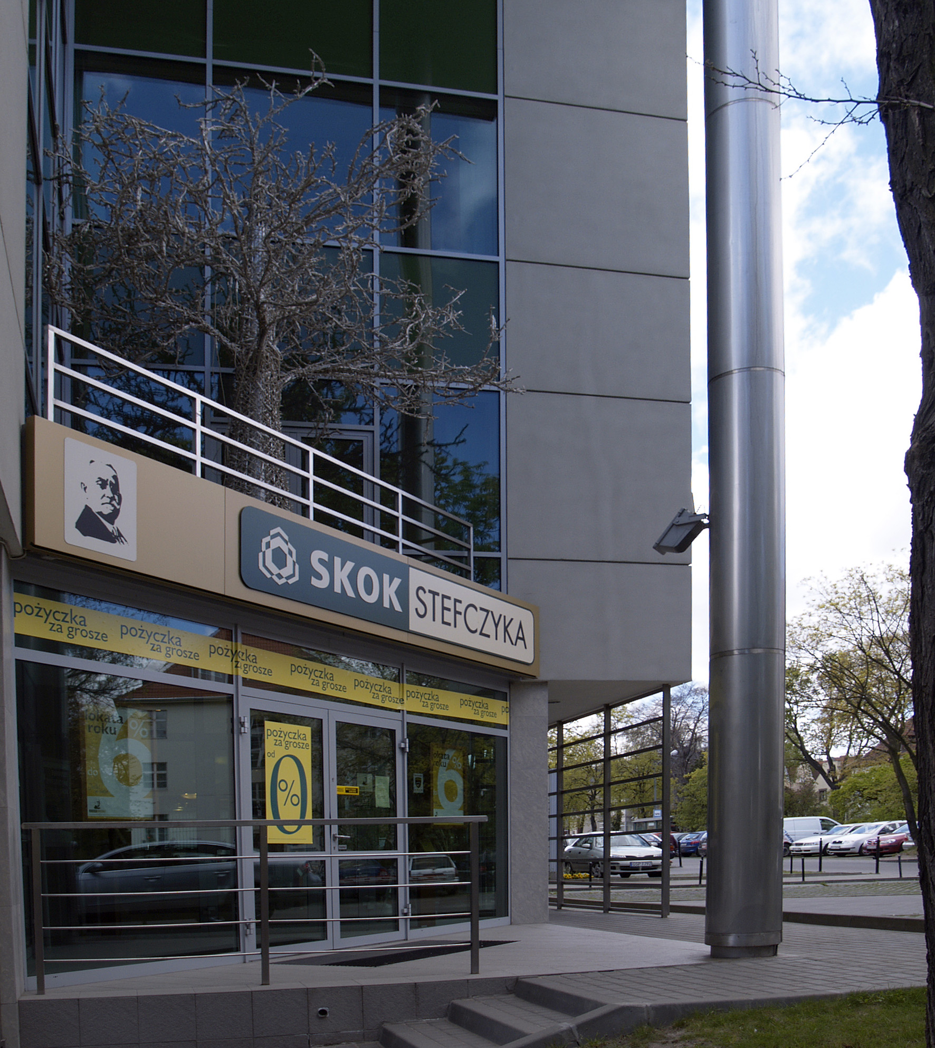
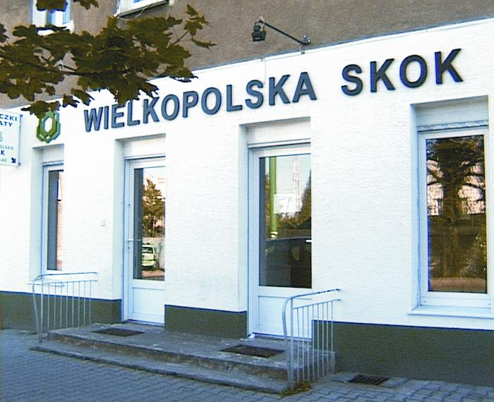
Over 1800 branches around the country… modern and in best locations

Slide 13
Credit Unions in Poland: Stages of Development
National Association of Cooperative Savings and Credit Unions (Kasa Krajowa)
Credit Union Mutual Insurance Society
Credit Union Life Insurance Society
„Asekuracja” Insurance Brokerage Co. Ltd
Credit Union Investment Funds Society
Credit Union Financial Society S.A. / „HSO” Software Co. Ltd.
Foundation for Polish Credit Unions - from the year 2011 the Foundation changed its name to FPZK Investments Co. Ltd.
CU Marketing Ltd since April 2012: Apella S.A.
Society for Promotion of Financial Education
Credit Union Arbitration (SAK)
Credit Union Management Limited Partnership Joint-Stock Co. (TZ SKOK S.K.A.)
Cooperative Research Institute and Credit Union Publishing House
Franciszek Stefczyk Foundation
Ecco Holiday – tour operator
SKOK Holding L.L.C. (Limited Liability Company)

Slide 14
CUs in Poland: Stages of Development, Stage 3
Further consolidation and standardization
  Some organizations develop specialized, economically self-sustainable structures, to provide certain services (like transportation, accounting, IT ) to their branches. The structure is still owned by the company.
  Other decide to buy services from external firms and they outsource some parts of their operations
Our strategy reads: combination of Shared Services Center and Outsourcing.
Risk-based management

Slide 15
CUs in Poland: Stages of Development, Stage 4
New CU Law (effective since 2012)
State regulation and supervision
State deposit guarantee
NACSCU role limited in area above
Companies supporting CUs exclusively have to more concentrate on services to CU Members and general public

Slide 16
Credit Unions in Poland: consolidated development
  Important factor of success: common, country-wide branding campaigns (with the use of one trade mark) financed through central marketing fund (with participation of all CUs, NACSCU, CU Insurance)
  One trade mark, one message – some examples:
  Safe, convenient place for affordable services:
  It is YOUR Credit Union, Close and Safe, Best deposits, best credits
  During crises:
  Don’t blame us: we are not banks
  We always stress: tradition, Polish capital, Polish ownership
  Making use of personalities: actors, sportsmen, etc. bringing positive associations (since 2011 the nationwide marketing persona for CU movement in Poland has been well-known actor).

Slide 17


Slide 18


Slide 19


Slide 20
NEW STRATEGY
STEFCZYK GROUP OF CREDIT UNIONS
The main objective is to integrate the system of credit unions by standardizing and unifying products, services and processes and applying best practices developed in Credit Unions and affiliated companies. The Group benefits from the effect of scale, concentration of resources and cooperation.

Slide 21






JOWISZ
UNII LUBELSKIEJ
SILESIA-CENTRUM

Slide 22
Kasy Stefczyka – Stefczyk Group of CUs
Unified :
lending processes and methods of credit analysis,
products, but with individually established prices,
design of branch outlook,
marketing,
methods of business planning
methods of risk management,
consulting and advisory services

Slide 23




Kasy Stefczyka are…
… clients of the same service providers
within the Center of Common Services (CUW),
a shared service center combined with outsourcing.
The same Service – The same Price.

Slide 24
CU Management Partnership:
Shared Services Center
designing of services,
loan processing, analysis, scoring of loan applications,
debt collection and restructuring,
recruitment and training,
motivation system,
legal counseling,
archiving of members documentation,
real estate administration service,

Slide 25
CU Management Partnership:
Shared Services Center
branch security,
arranging of the locations for CUs branches,
cash management and security transport,
administration of the fleet of vehicles,
leasing,
shipment of mass correspondence,
stationery supply,
ATM service.

Slide 26
Media Company
marketing campaigns,
public relations,
publishing,
creation of multimedia,
organization of events,
web services.

Slide 27
CU Financial Society S.A.
Development of software matching the ongoing development of the credit unions, their operations and range of products and services
Internet banking (e-skok)
Call center services for credit unions
Electronic card processing, e-commerce, international money transfers
Service of workstations and user support (Service Desk)
Administration of telecommunications
Hardware renting, data storage, servers.

Slide 28
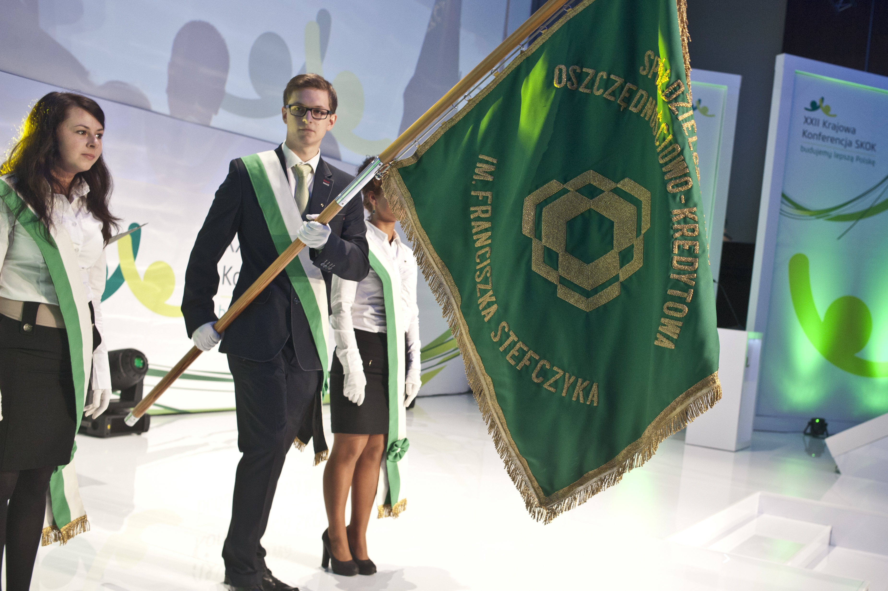
Achievements:
Country largest network offering financial services (by No of branches)
6% of total consumer lending (comparing to commercial banks)
2% of consumer savings market
Second largest CU movement in Europe

Slide 29
Credit Unions in Poland 1992 – June 2014
Year | No of branches | No. of members (thousands) | Assets (thousands of PLN) | Savings (thousands PLN) | Loans (thousands of PLN) )
1992 | 13 | 14 | 4 277 | 3 565 | 2 985
2012 | 1 987 | 2 591 | 16 805 349 | 15 491 190 | 11 090 601
June 2014 | 1874 | 2 663 | 18 226 048 | 16 992 322 | 12 267 426
1 ZAR = 0,29 PLN

Slide 30
Unique social role of credit unions
Financial self – help, non-profit organizations
Facilitating access to financial services primarily for persons of limited means (low-income) and within areas with low – developed infrastructure
Promotion of thrift between members
Creation of sources for consumer lending with reasonable interest rates
Fighting usury and financial exclusion
Democratic management, development of local community entrepreneurship
Financial and economic education
Members
Employees/volunteers
Local communities

Slide 31
POLISH CREDIT UNION SYSTEM
Typical products and services offered
by Polish credit unions:
personal accounts
term deposits
savings accounts
loans and credits (including mortgage lending)
business services: accounts, credits and money transfers
credit and debit cards
payment settlements
insurance services
investment funds products
Internet banking

Slide 32
Some final thoughts:
Collaboration is important factor of development: use effect of scale, join forces, build added value, share internally accumulated know-how
Collaboration may have different forms on different stages of movements’ development. Be critical: there is no single model for every time – religions deal with eternity, social enterprises deal with social problems, market, civilization and cultural changes
It always requires leadership and trust
Communicate!
Be different from commercial industry: follow CU philosophy. Always put members first – be responsible

Slide 33
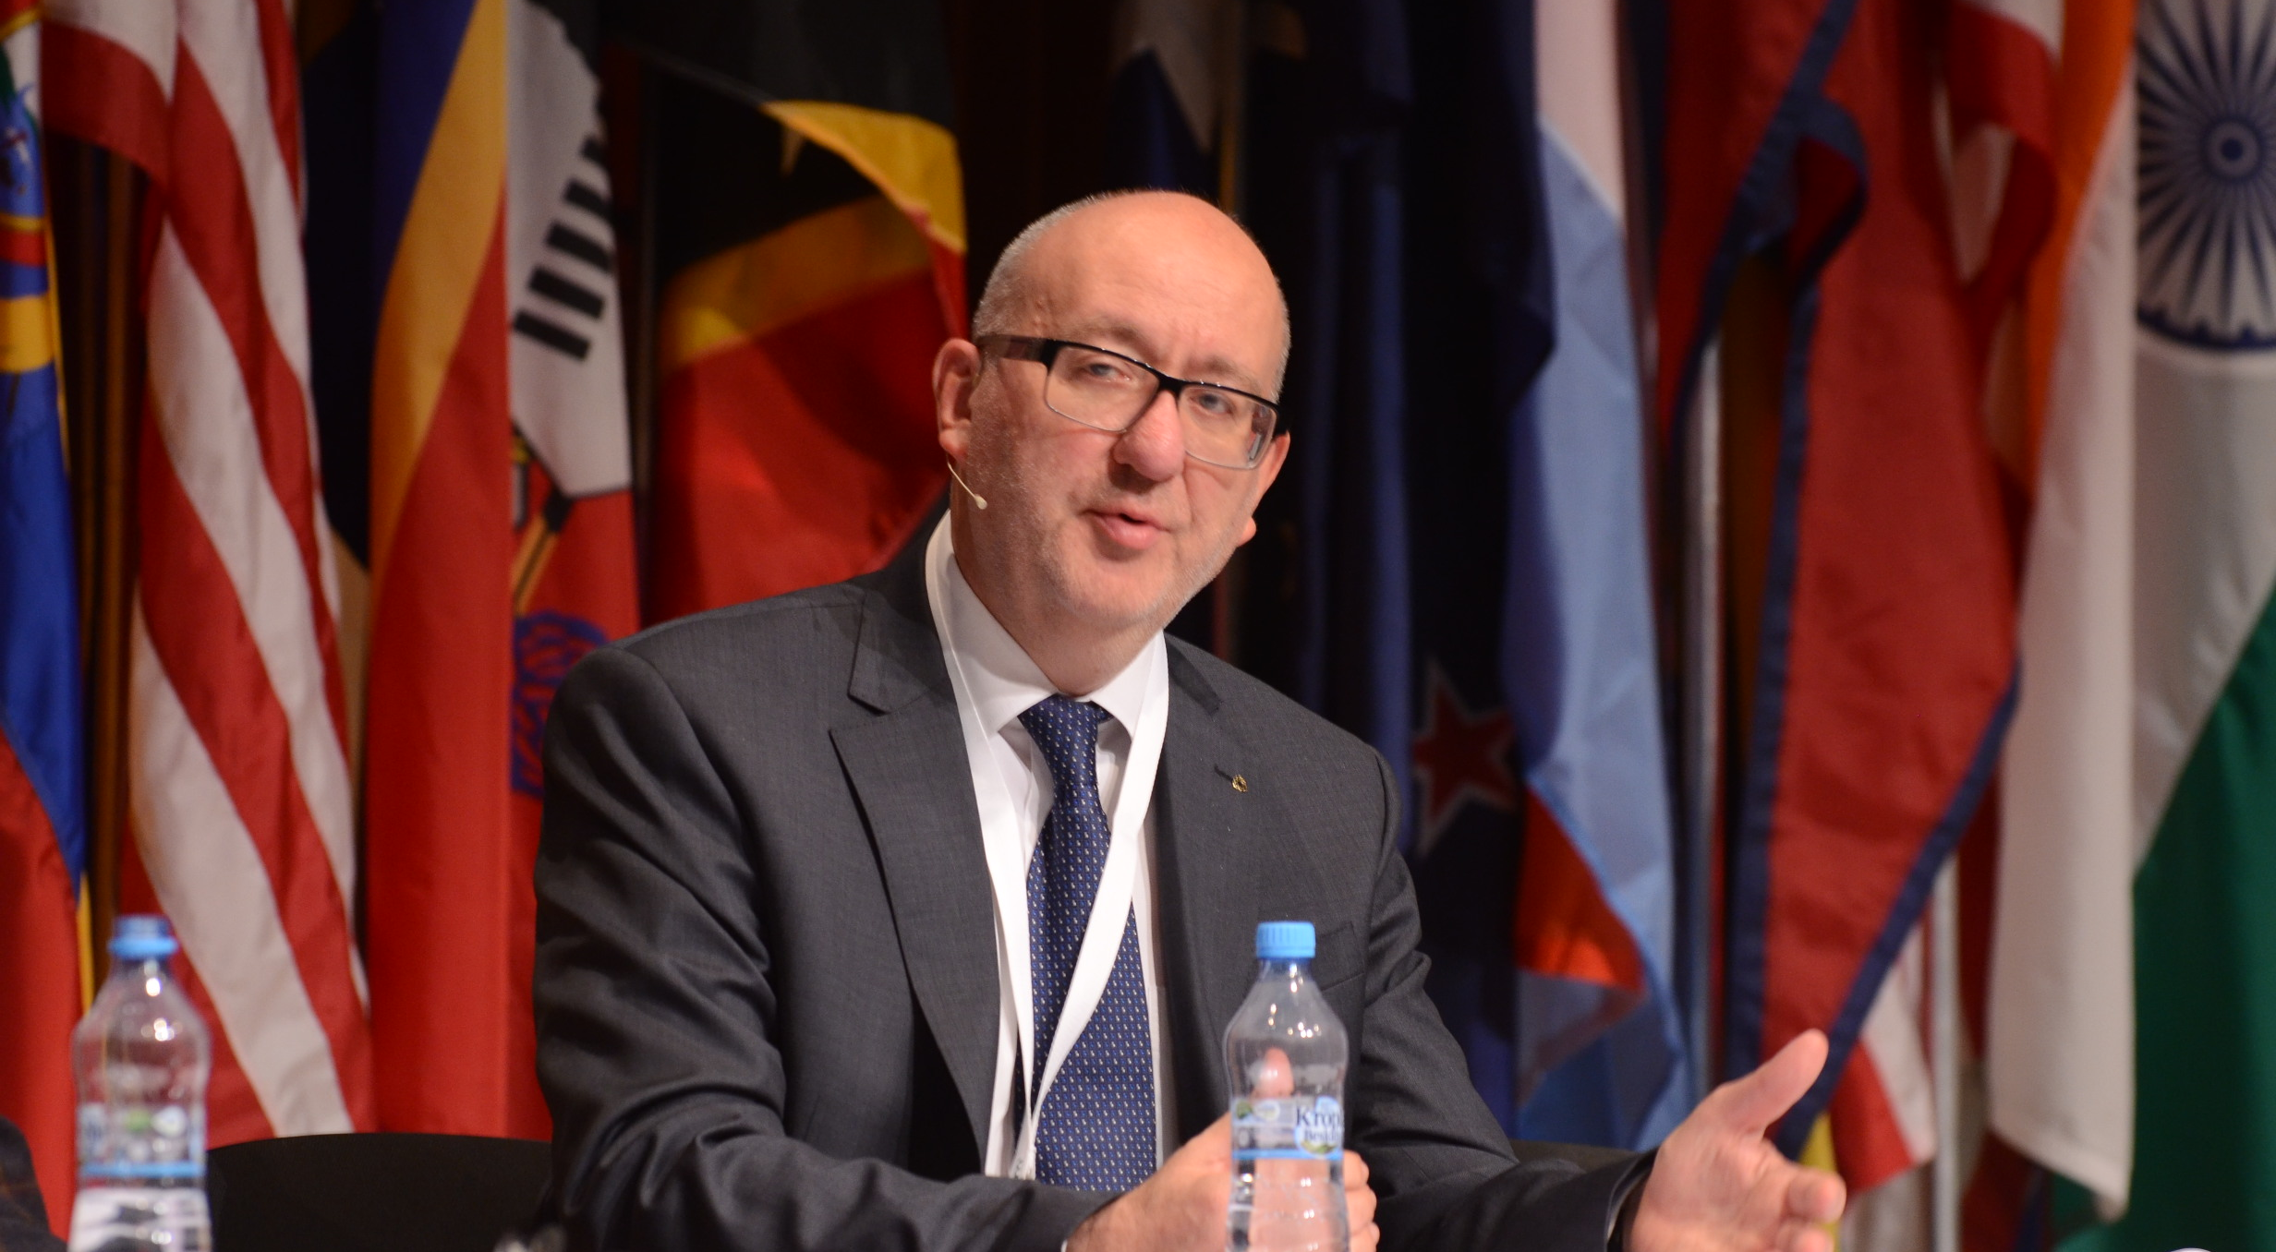
THANK YOU FOR YOUR ATTENTION !
More info:
www.skok.pl
Contact: kskok@skok.pl

